Slide 1
Welcome
to
August LIN Meeting !

Slide 2









2015 CARNM/CCIM Sponsors

Slide 3
Member Introductions

Slide 4
Announcements

Slide 5
2015 CARNM/CCIM Sponsors

Slide 6

REALTOR® Party Mobile Alerts!
Take Out Your Phones!
It’s time to take action & help CARNM!
Text the word: ’Help’ to 30644
This will get you signed up to receive text messages
to take action quickly from your mobile device.
It’s easy and quick to stay informed!
CARNM must have member involvement
on NAR Calls to Action!
Thank you!
Notes:
LIN Announcement slide for REALTOR Party Mobile Alert 5.20.15

Slide 7

Business Ethics in Real Estate
October 1, 2015
8:00 a.m. – 12:00 p.m.
$60 members/$75 non-member
4 CE Credits
Get the REALTOR® Code of Ethics requirement done early and register today!

Slide 8


CCIM CI 101
Financial Analysis for Commercial Investment Real Estate
October 12 – 15, 2015
8:00 a.m. – 5:00 p.m.
Fidelity National Title – 8500 Menaul Blvd NE
Register Online

Slide 9

Legal Issues on Commercial
Leases, LOIs and TIs
October 29, 2015
1:00 – 5:00 p.m.
$60 CARNM members
$75 Other Real Estate Licensees
$160 Attorneys
After October 26: $75 CARNM members
$90 Other Real Estate Licensees
$180 Attorneys
NMREC Approved 4.0 CE
MCLE Approved 3.7 G

Slide 10

Next LIN Meeting
September 23, 2015
4001 Jefferson Plaza NE
Debbie Dupes, CCIM
Dan Newman, SIOR
CBRE, Inc.

Slide 11
Any Other Announcements?

Slide 12
First Plaza

Slide 13
New Listings

Slide 14
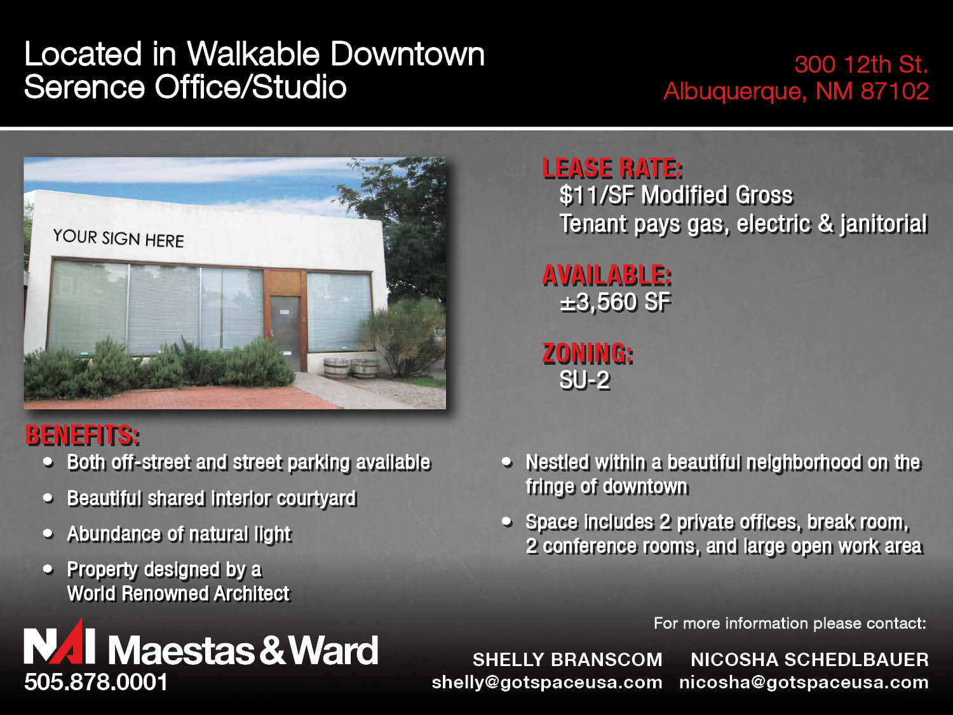

Slide 15
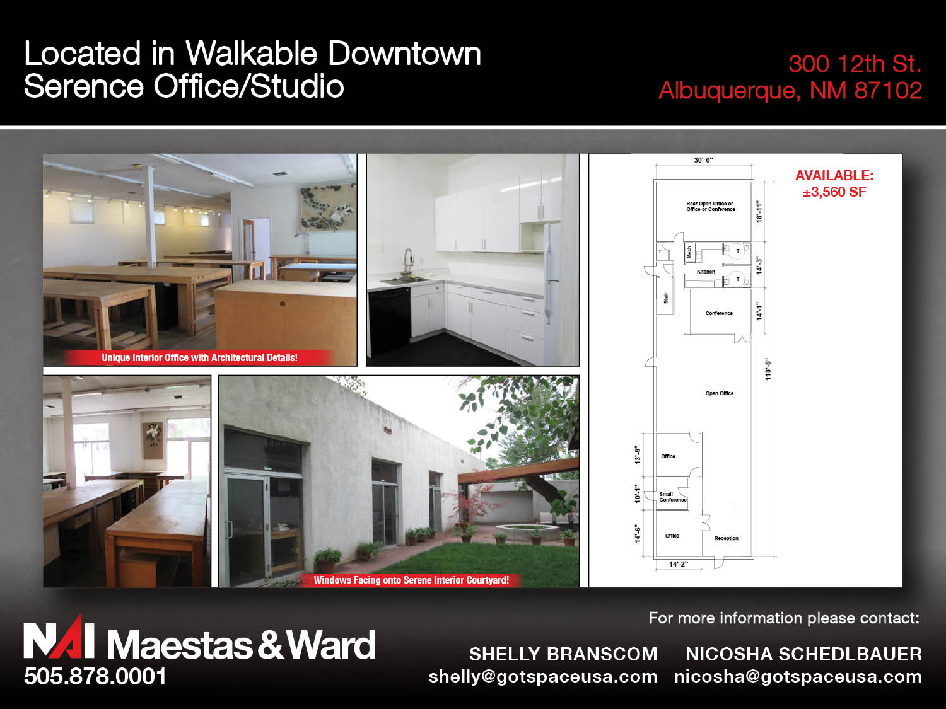

Slide 16
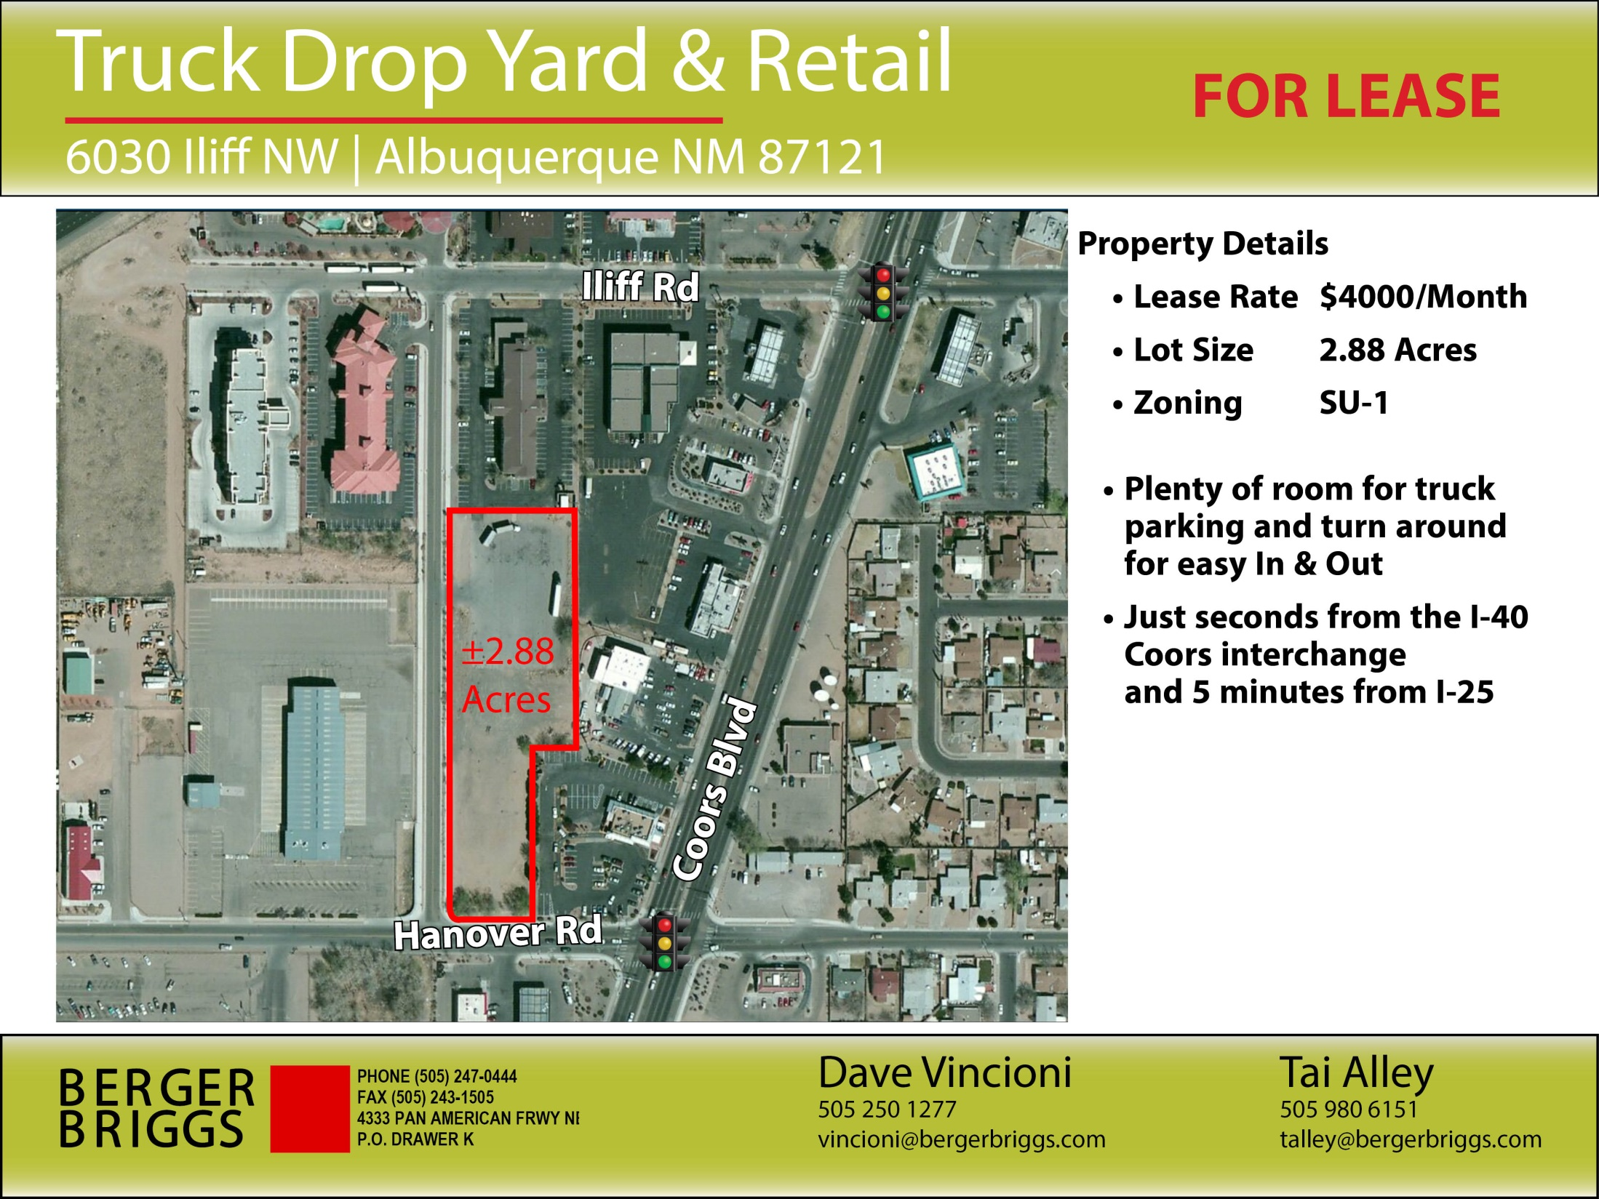

Slide 17
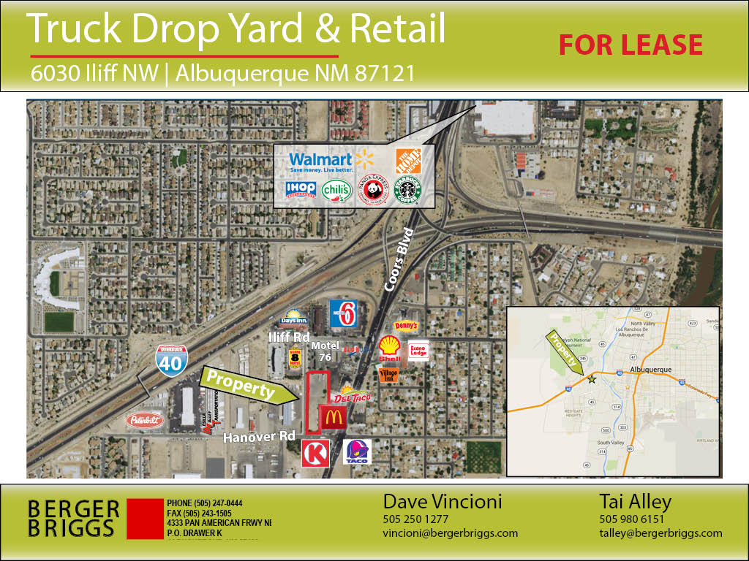

Slide 18
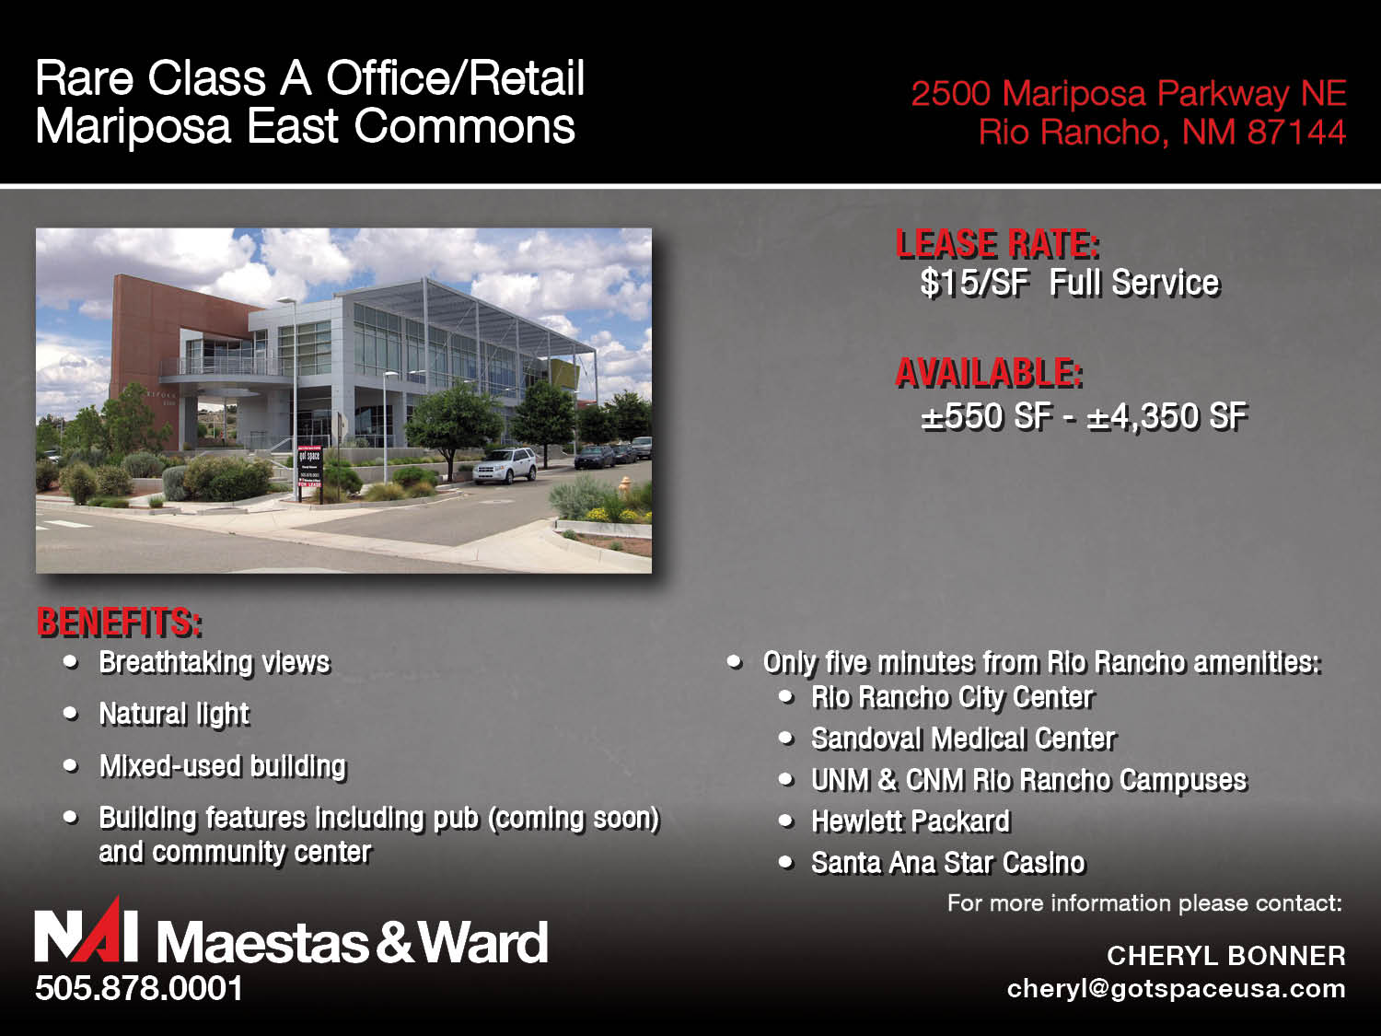

Slide 19
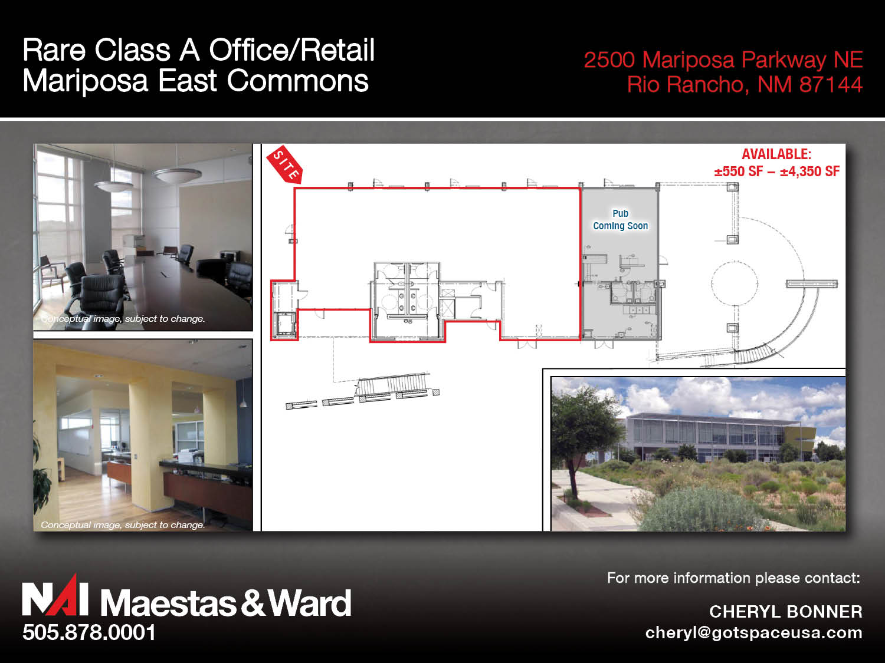

Slide 20
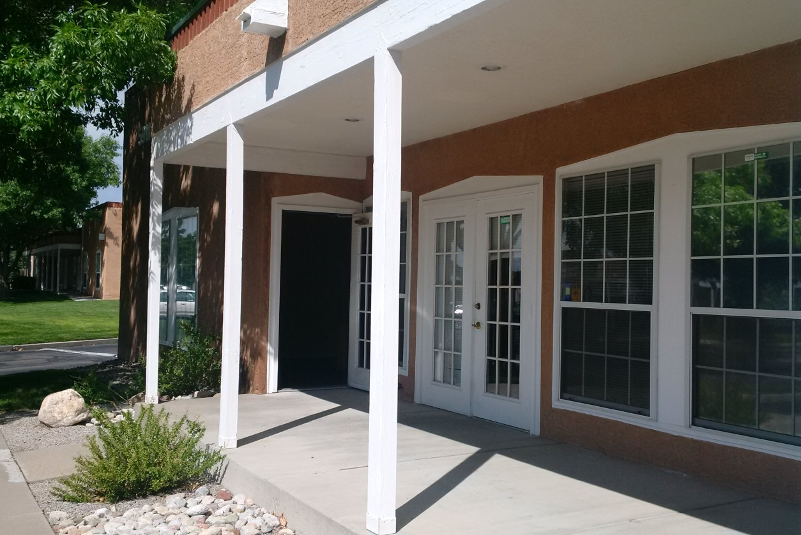
5911 Jefferson St NE
Albuquerque, NM 87109
HIGHLIGHTS
Lease Rate: $17.50/SF
Lease Type: Modified Gross
Zoning: IP
Available Space: Suite A ±1,618 SF
Building Amenities:
Beautiful office in desirable North I-25 area
Convenient location with easy access to I-25
Suite A build-out includes:
  4 offices with windows
  Open work area
  Reception area
  Break room
  Storage
  2 restrooms with showers
  Wired for alarm system
  Direct outside entry
Assigned parking at the door AND free covered parking
ANNE APICELLA
Senior Associate
+1 505 880 7059
Albuquerque, NM
anne.apicella@colliers.com
COLLIERS INTERNATIONAL
+1 505 883 7676 Main
2424 Louisiana Blvd NE, Suite 300
Albuquerque, NM 87110

Slide 21
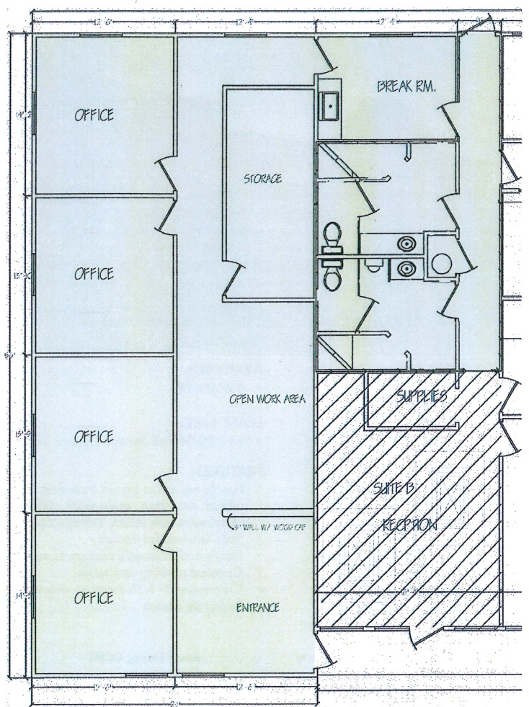
5911 Jefferson St NE
Albuquerque, NM 87109
FLOOR PLAN
ANNE APICELLA
Senior Associate
+1 505 880 7059
Albuquerque, NM
anne.apicella@colliers.com
COLLIERS INTERNATIONAL
+1 505 883 7676 Main
2424 Louisiana Blvd NE, Suite 300
Albuquerque, NM 87110

Slide 22
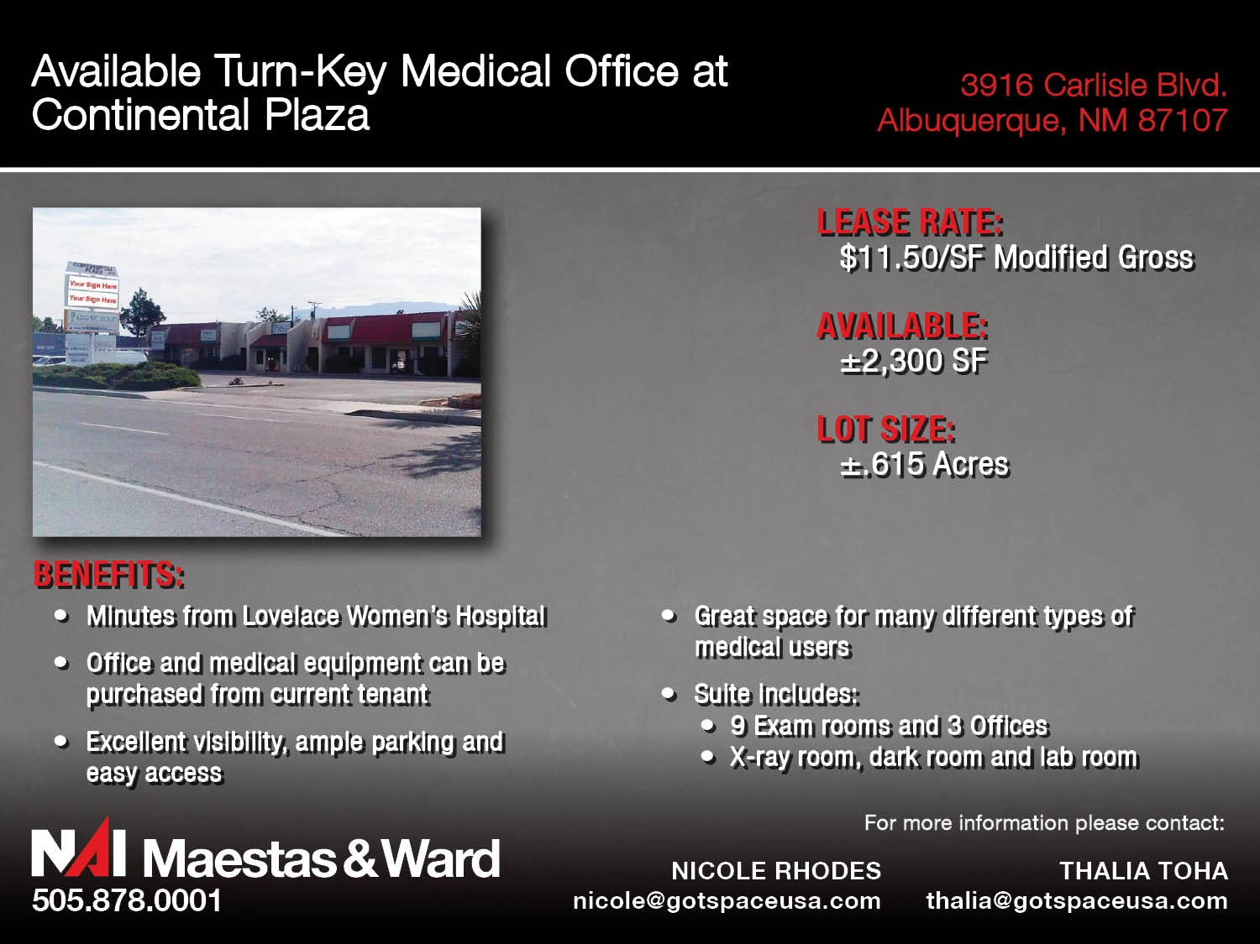

Slide 23
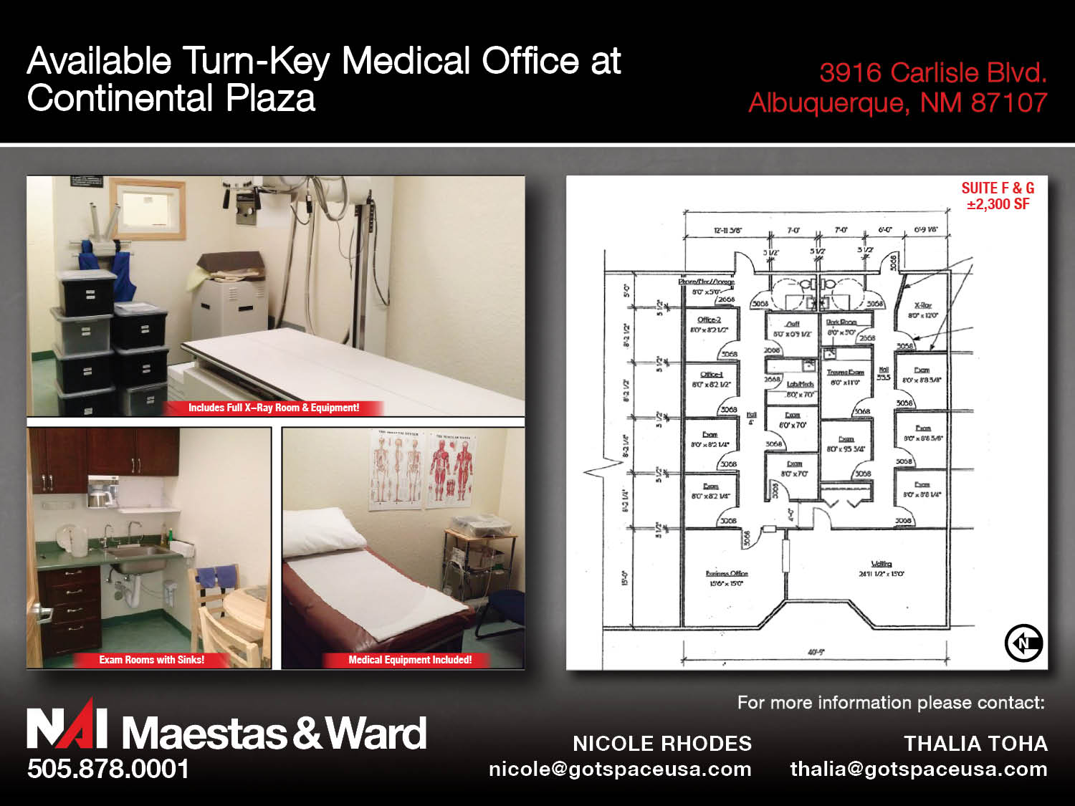

Slide 24
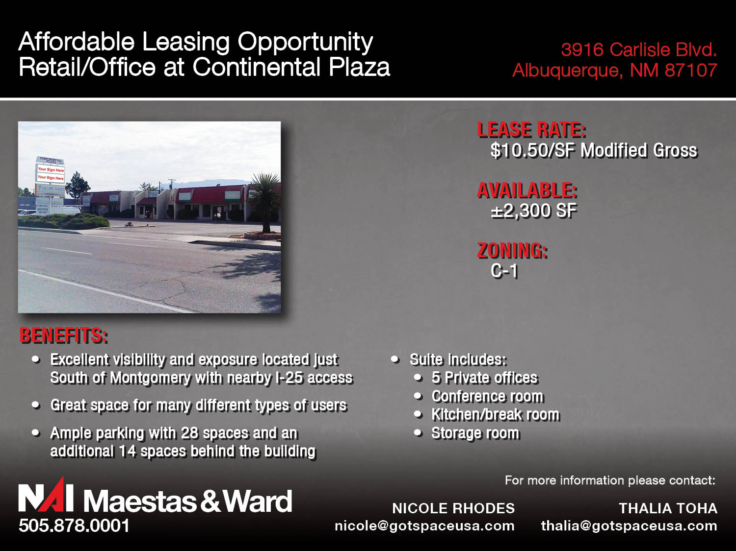

Slide 25
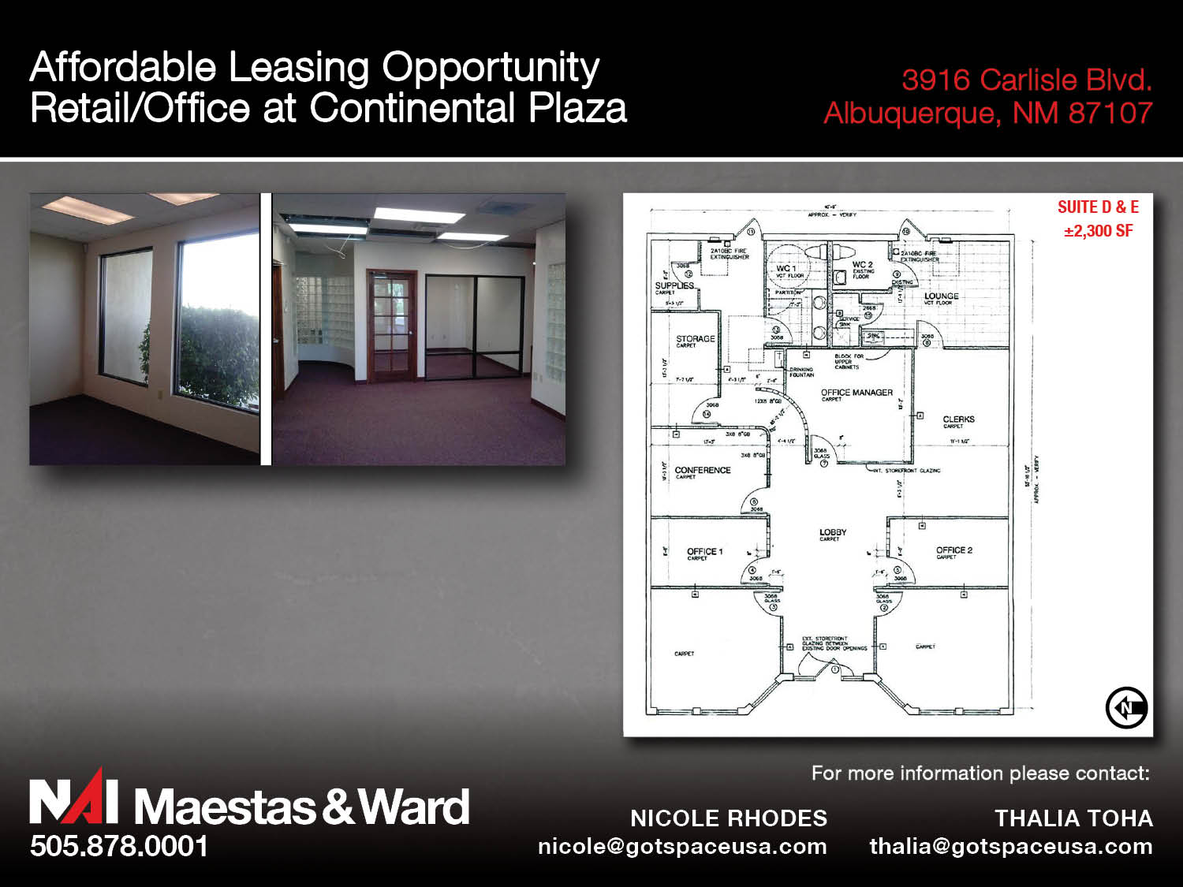

Slide 26
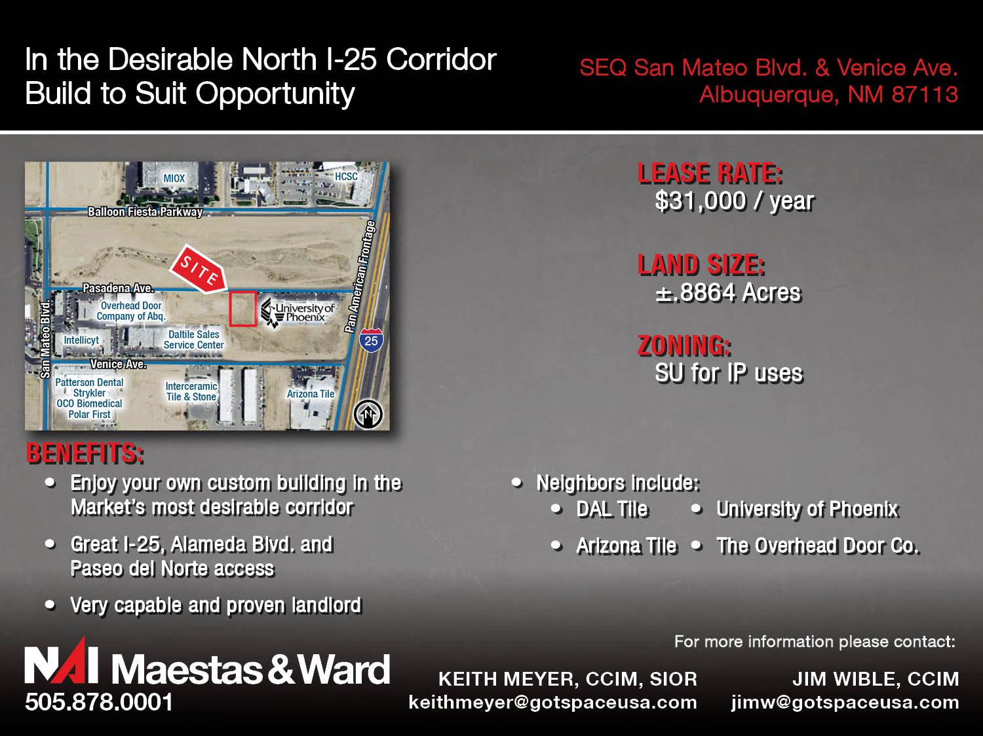

Slide 27
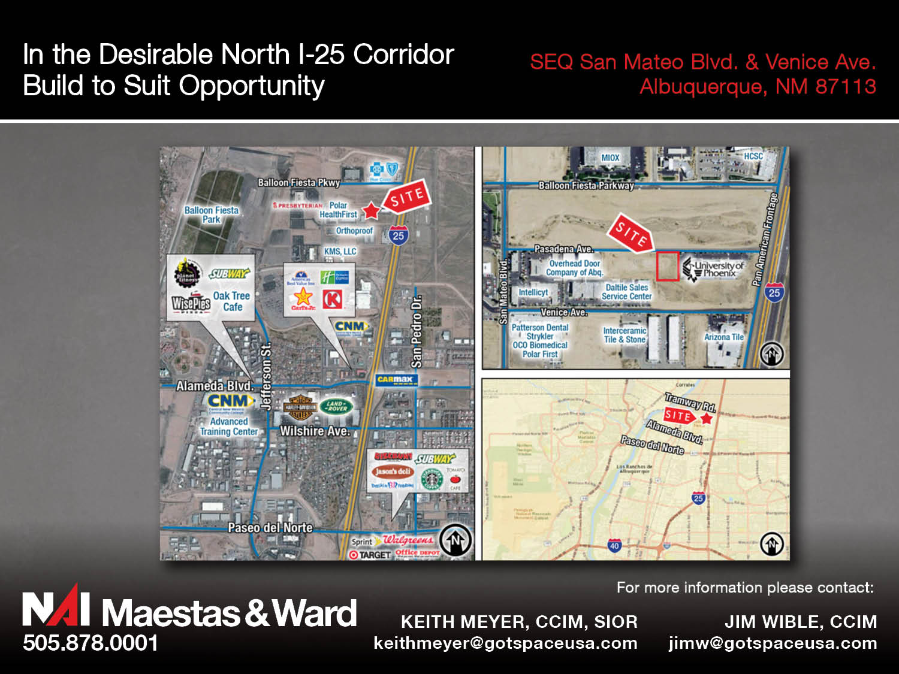

Slide 28
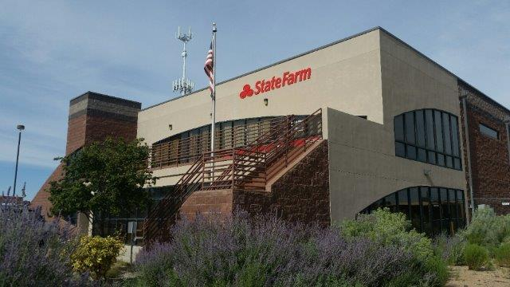

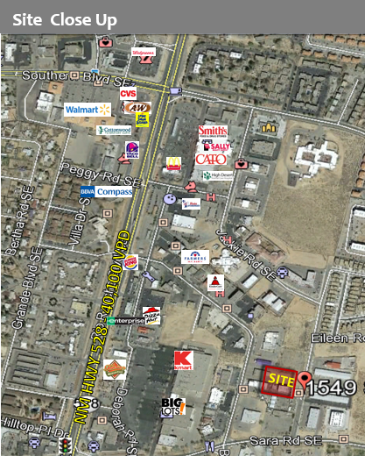
Rio Rancho Office for Lease
1549 Stephanie Road SE
Rio Rancho, NM 87124
^{Lease Rate: $15.18 / SF Gross}
Available Space: +/- 790 SF – +/-1,580 SF
^{Parking: 5:1,000}
^{Building Size: ±11,600 SF}
^{Land: ± 1.31 Acres}
^{Zoning: C-2}
^{Available Units:}
^{Unit B: +/- 790 SF, $1,000/Mo}
^{Unit C: +/- 790 SF, $1,000/Mo}
^{Features:}
^{Easy access from Sara Road}
Excellent Signage (2 sign locations per unit)
^{New Stucco}
^{Modern design}
^{Beautiful mountain views}
Coralee Quintana
Coralee@go-absolute.net
505-639-1266
Absolute Investment Realty
4105 Silver Ave SE
Albuquerque, NM 87108
The information contained herein is believed to be reliable. While we do not doubt the accuracy, we have not verified it and make no guarantee, warranty or representation about it. It is your responsibility to independently confirm its accuracy and completeness.
www.go-absolute.net

Slide 29
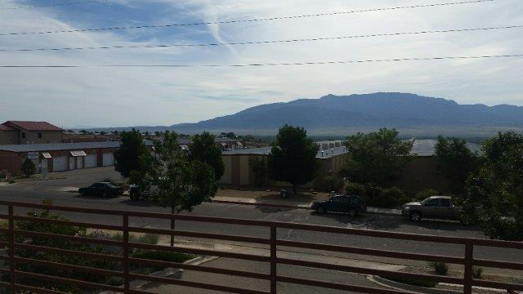
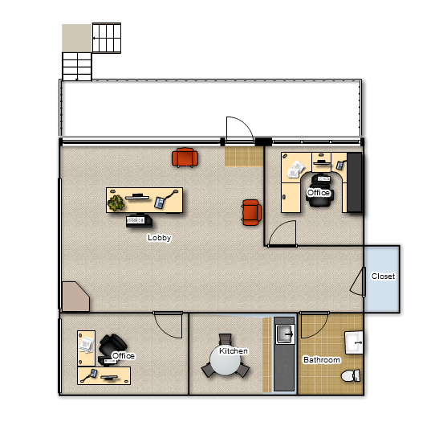
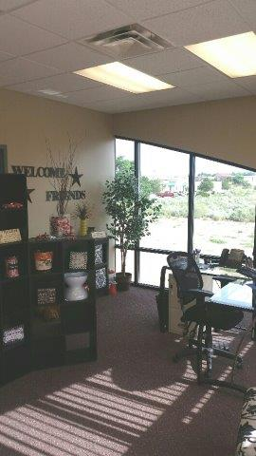
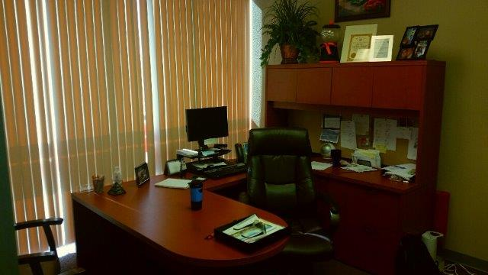
Floorplan
1549 Stephanie Road SE
Rio Rancho, NM 87124
Unit B, Patio, Foyer + 2 offices
Absolute Investment Realty
4105 Silver Ave SE
Albuquerque, NM 87108
Coralee Quintana
Coralee@go-absolute.net
505-639-1266
www.go-absolute.net

Slide 30
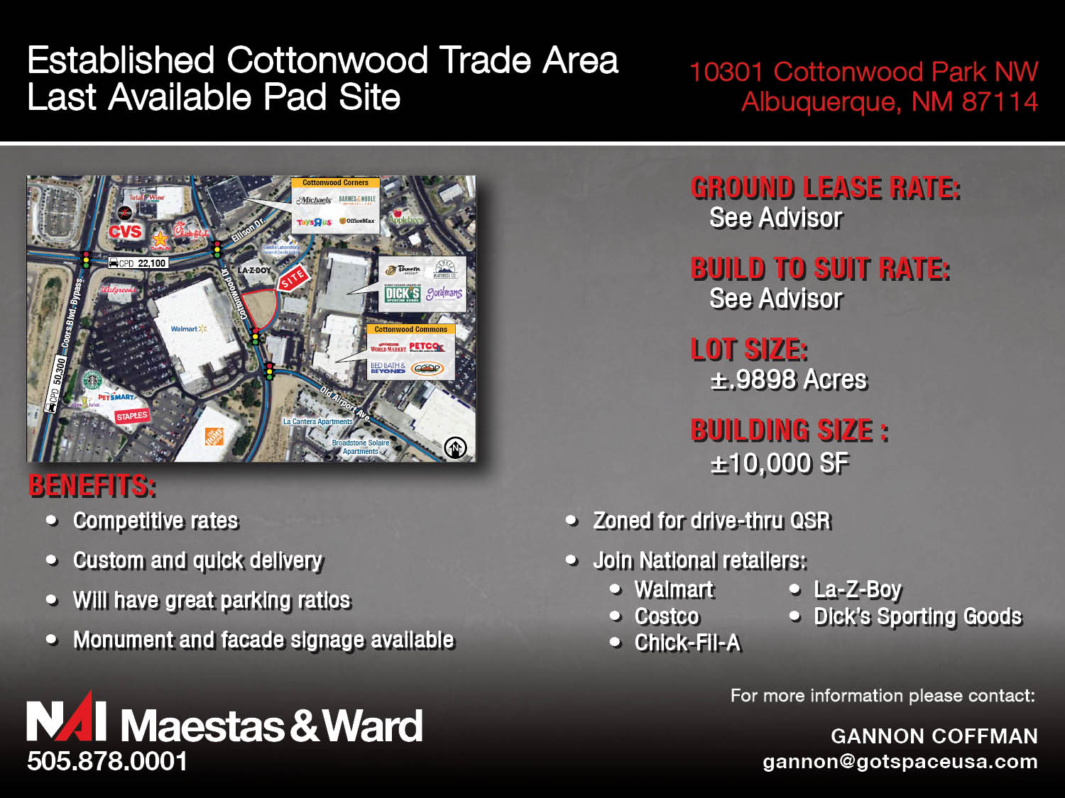

Slide 31
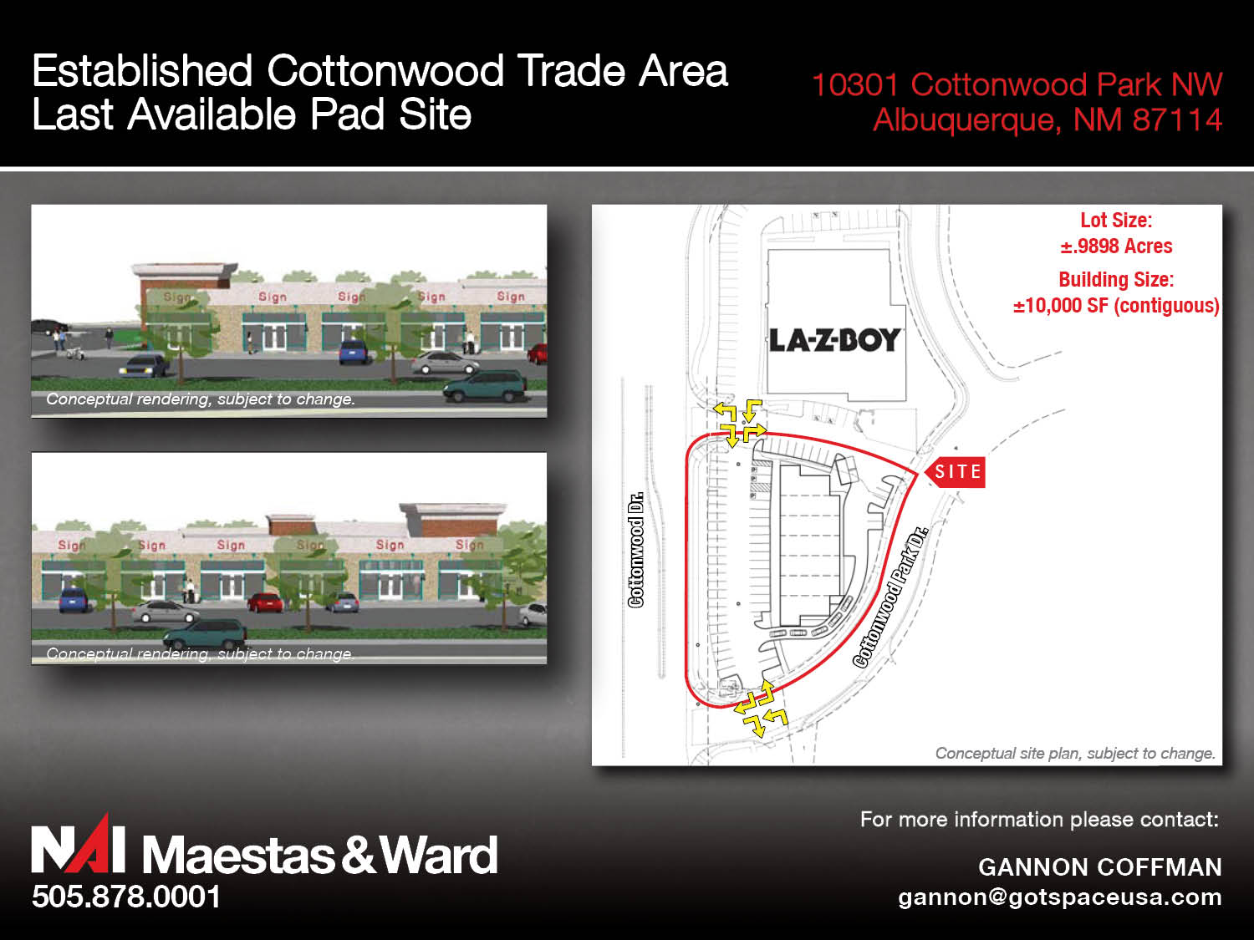

Slide 32
Any Other New Listings?

Slide 33
Changes

Slide 34
Wants & Needs

Slide 35
Thank You!

Slide 36
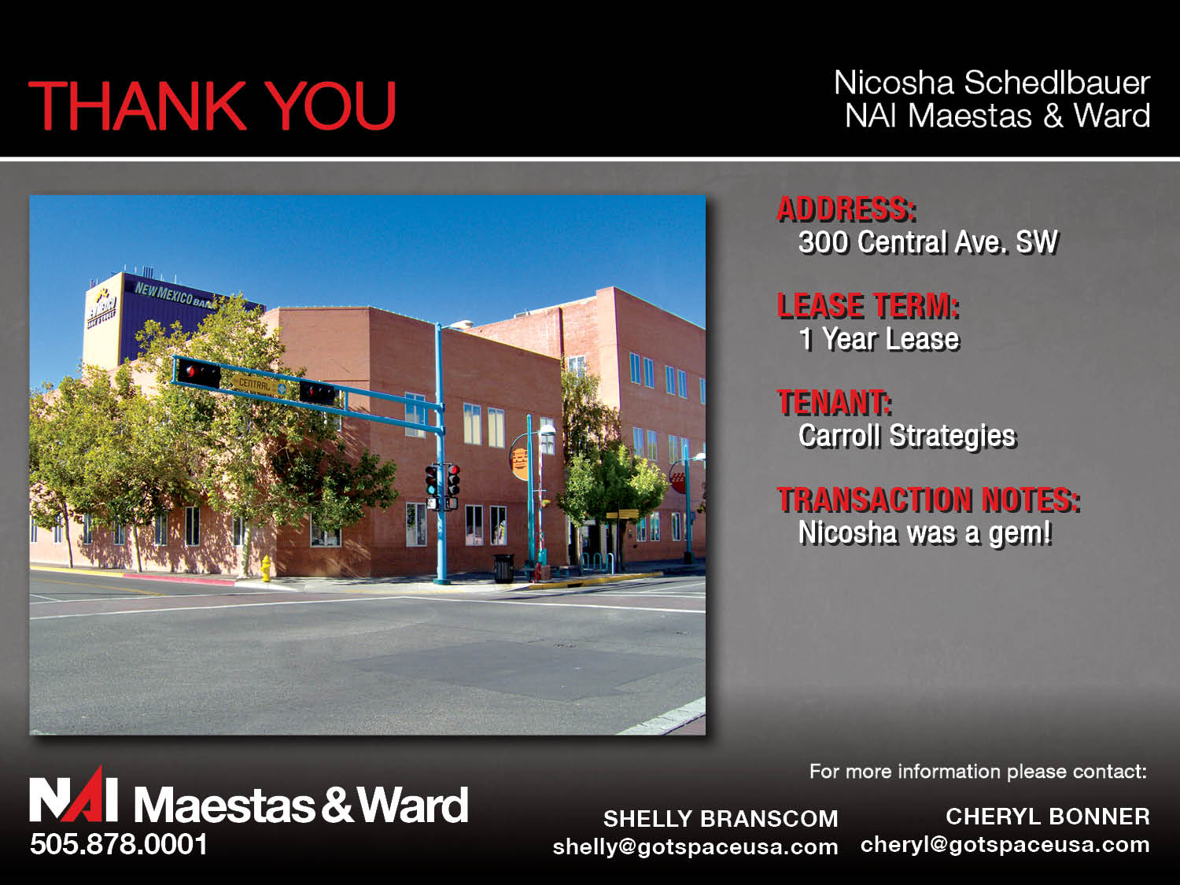

Slide 37
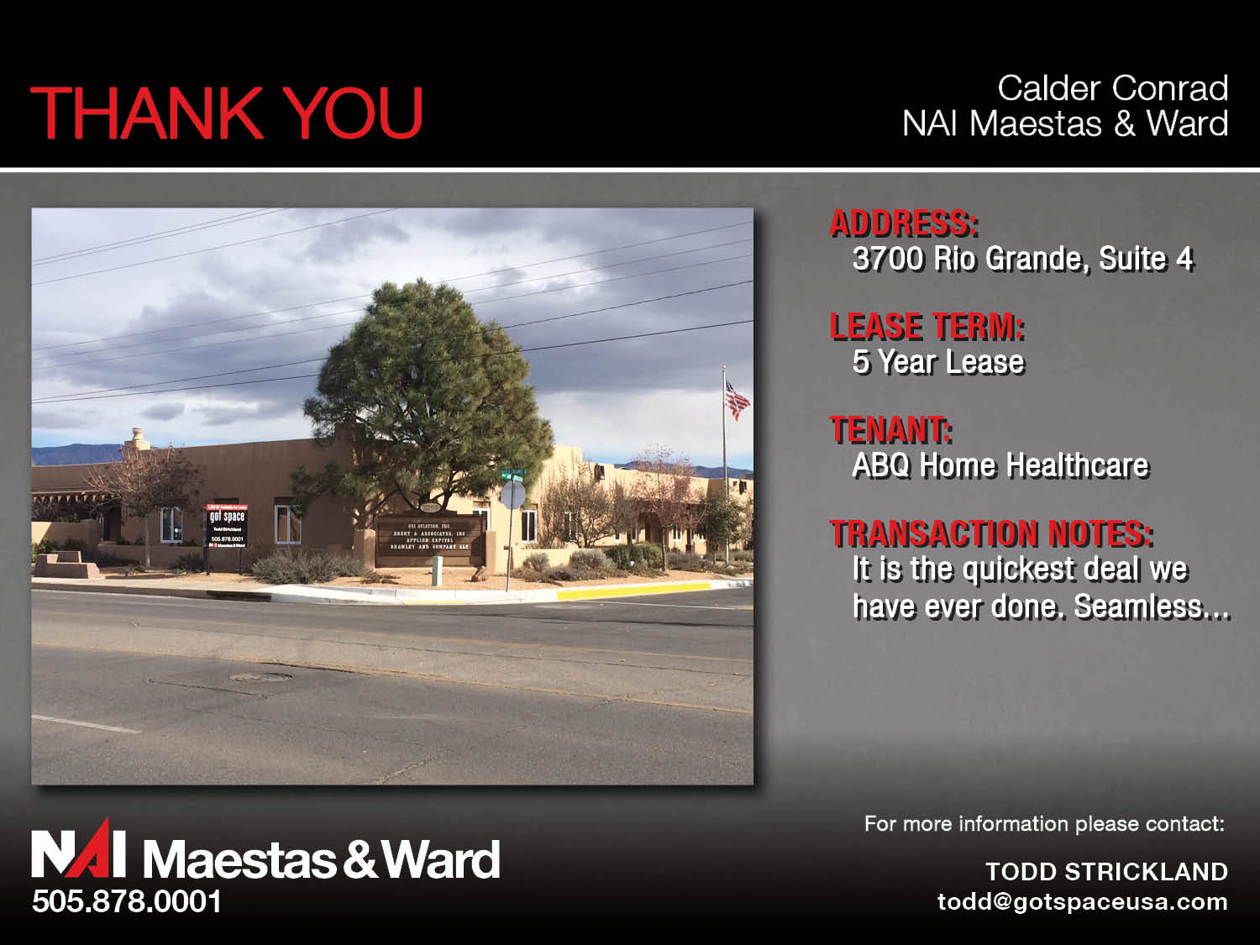

Slide 38
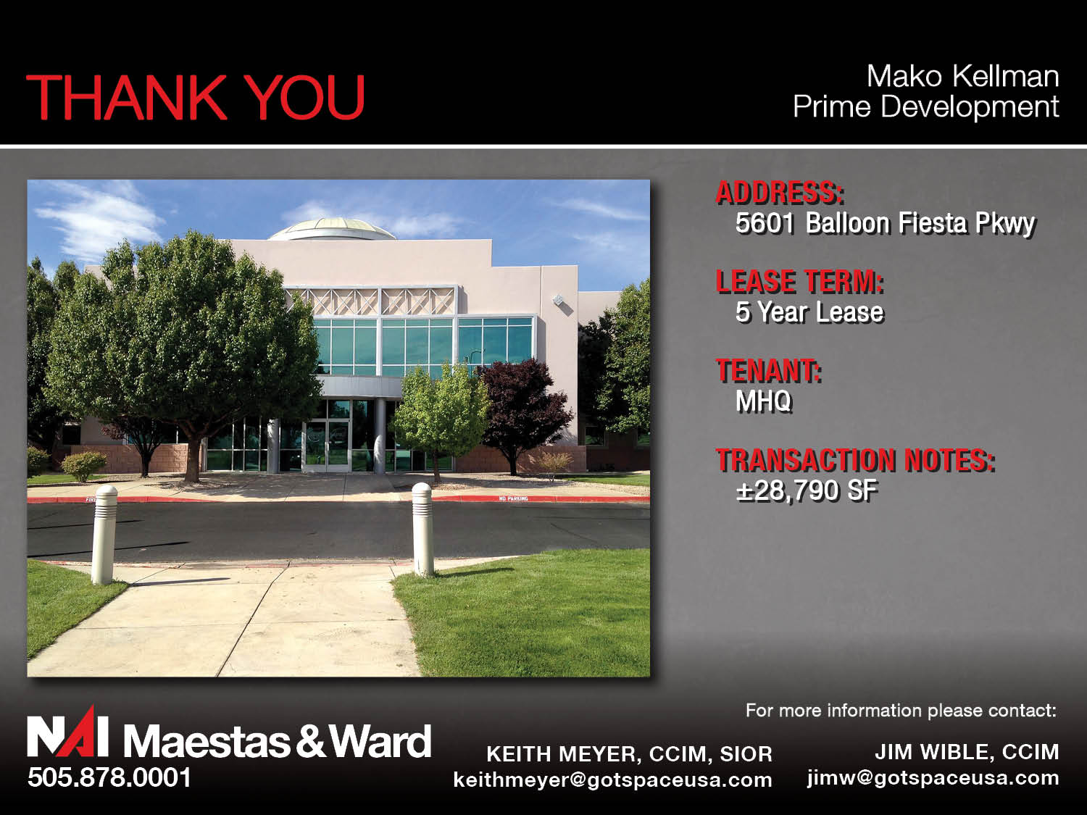

Slide 39
Any More Thank-You’s?

Slide 40

Prizes

